Slide 1
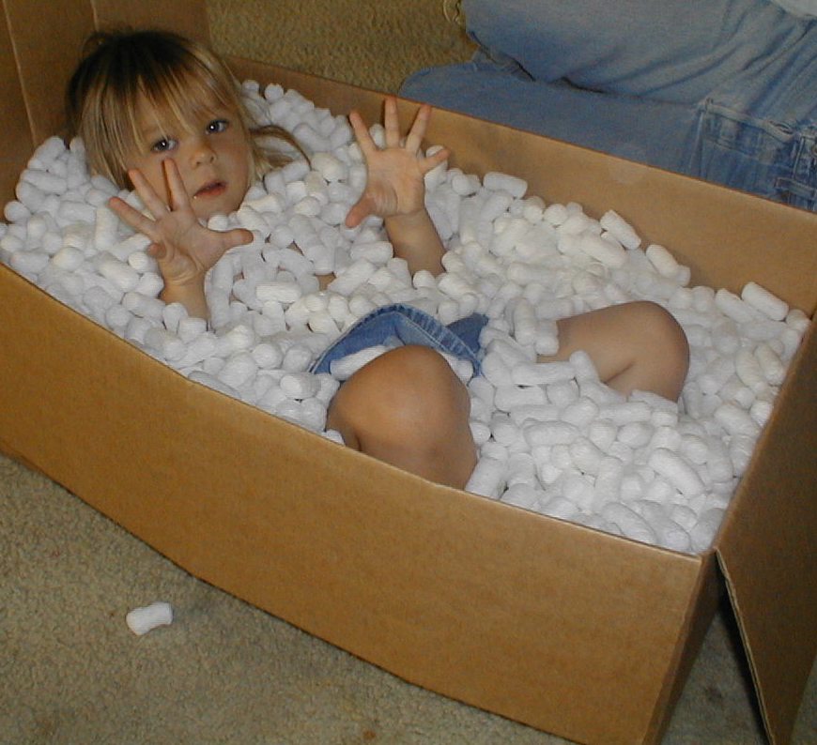
Categorical data analysis:
For when your data DO fit in little boxes
AnnMaria De Mars, Ph.D.
The Julia Group
Santa Monica, CA

Slide 2
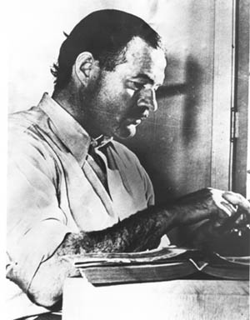
Anyone who thinks he knows all of SAS is clinically insane
Okay, Hemingway didn’t really
say that, but he should have

Slide 3

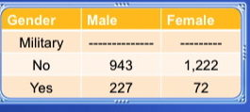
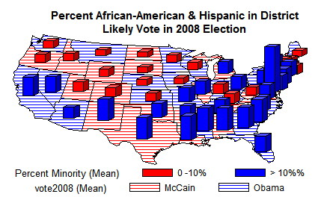
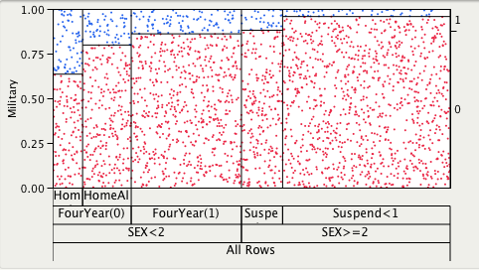
Descriptive Statistics
PROC FREQ *
PROC UNIVARIATE
PROC TABULATE
ODS graphs *
SAS/Graph
Graph – N- Go
SAS Enterprise Guide
Notes:
Just so you know, there is a LOT you can do with PROC FREQ for categorical data, and we will get to that shortly.

Slide 4
Other PROCs
LOGISTIC *
CATMOD
CORRESP
PRINQUAL
SURVEYLOGISTIC

Slide 5

Hybrids
T-test
ANOVA
NPAR1WAY
FACTOR
REG

Slide 6

Our secret plan
Descriptives
Chi-square
Secrets of PROC FREQ
Logistic regression

Slide 7
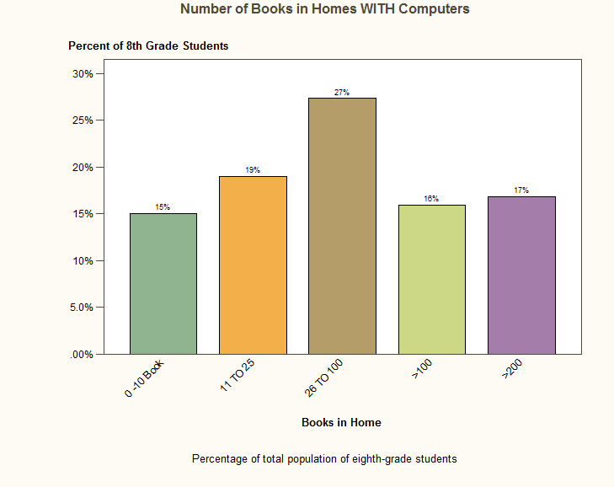
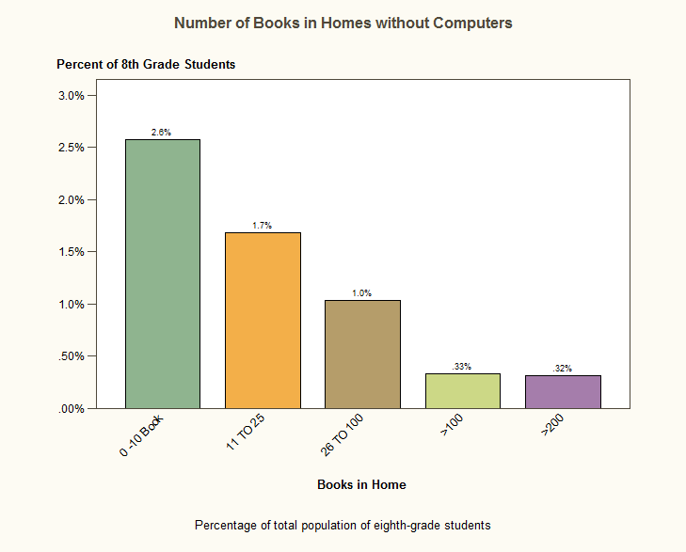

Homes without computers have fewer books
Graphs with SAS On-Demand

Slide 9
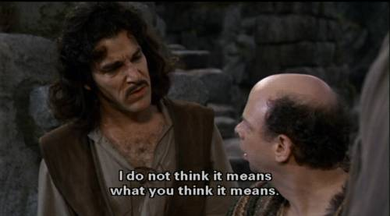
You keep saying that word

Slide 10
We all knew FREQ DID THIS
PROC FREQ DATA = dsname ;
TABLES varname1 * varname2 / chisq ;
YOU GET
Chi-square value (several)
Phi coefficient
Fisher Exact test (where applicable)

Slide 11
Pearson Chi-Square
Tests for a relationship between two categorical variables, e.g. whether having participated in a program is related to having a correct answer on a test.
Assumes randomly sampled data
Assumes independent observations
Assumes large samples

Slide 12
Mothers Education &
Failing a Grade

Slide 13
Fisher’s exact test
Is used when the assumption of large sample sizes cannot be met
There is no advantage to using it if you do have large sample sizes

Slide 14
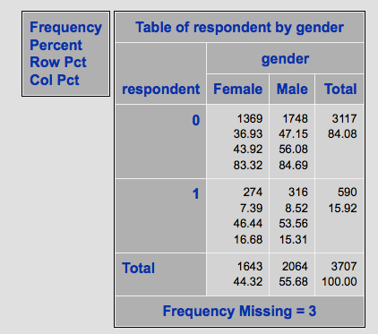
Test for bias in sample

Slide 15
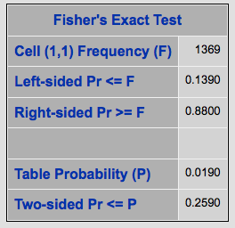
Fisher – magically happens
Notes:
The table probability equals the hypergeometric probability of the observed table, and is in fact the value of the test statistic for Fisher’s exact test. For tables, one-sided -values for Fisher’s exact test are defined in terms of the frequency of the cell in the first row and first column of the table, the (1,1) cell. Denoting the observed (1,1) cell frequency by , the left-sided -value for Fisher’s exact test is the probability that the (1,1) cell frequency is less than or equal to . For the left-sided -value, the set includes those tables with a (1,1) cell frequency less than or equal to . A small left-sided -value supports the alternative hypothesis that the probability of an observation being in the first cell is actually less than expected under the null hypothesis of independent row and column variables.

Slide 16
A bunch of things you may not know Proc Freq Does

Slide 17

Other simple statistics
Binomial tests
Confidence intervals
McNemar
Odds ratios
Cochran-Mantel- Haenszel test
Because, obviously, not everyone has
the same tastes
Notes:
While binomial tests, confidence intervals and odds ratios aren’t a usual part of the output requested on categorical data, there are always those people who exist to annoy you. Cough – medical students – cough
You use the Cochran–Mantel–Haenszel test (which is sometimes called the Mantel–Haenszel test) for repeated tests of independence. There are three nominal variables; you want to know whether two of the variables are independent of each other, and the third variable identifies the repeats. The most common situation is that you have multiple 2×2 tables of independence, so that's what I'll talk about here. There are versions of the Cochran–Mantel–Haenszel test for any number of rows and columns in the individual tests of independence. Technically, the null hypothesis of the Cochran–Mantel–Haenszel test is that the odds ratios within each repetition are equal to 1.
http://udel.edu/~mcdonald/statcmh.htm l

Slide 18

What about this ?
PROC FREQ DATA = dsname ;
TABLES varname /
BINOMIAL (EXACT P = .333)
ALPHA = .05 ;
Notes:
Example and explain – chi-square, phi and Fisher

Slide 19
What’s it Do
The binomial (equiv p = .333) will produce a test that the population proportion is .333 for the first category. That is “No” for death. A Z-value will be produced and probabilities for one-tail and two-tailed tests.
The exact keyword will produce confidence intervals and, since I have specified alpha = .05, these will be the 95% confidence intervals.

Slide 20
Not New

Slide 21
Hmmm…. This is interesting

Slide 22
Null rejected !

Slide 23
Some More Coding
PROC FREQ DATA = dsname ;
TABLES varname1 * varname2 / AGREE ;
FOR CORRELATED DATA

Slide 24
Correlated Data

Slide 25
McNemar’s Test

Slide 26
Cohen’s Kappa
= Probability observed – Probability expected
1 – Probability expected
1.0 = perfect agreement
Negative Kappa is not an error, it means the two agree less than chance

